Slide 1

Mushroom Classification
Team members: Cade Roberts, Lance Cross, Naomi Sterlingsdottir, Ying Zheng

Slide 2

In Memory of Lance Cross

Slide 3
Background
Over 14,000 identified species of mushrooms
They can be poisonous, edible or medicinal
Ways to tell the difference is the characteristics of the mushroom include cap color, gill attachment, gill color, and others.
Types of mushrooms vary depending on regional location, and because of this, specific species identification can be difficult
The combined data set we analyzed contains many species from the amanita genus as well as Lepiota, both of which contain edible and inedible mushrooms.

Slide 4
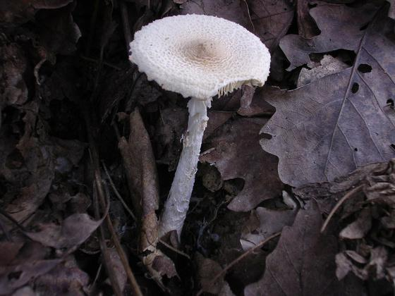
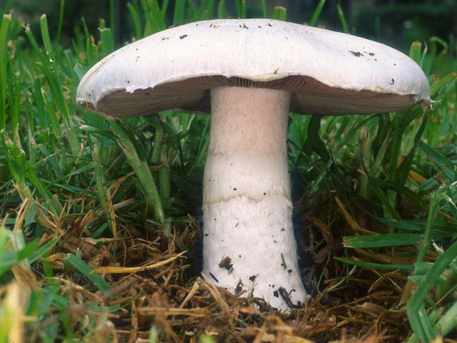
Dataset
Obtained by the UCI Machine Learning Repository and Phillips University Marburg
Contains two mushroom families: Agaricus and Lepiota families
58 attributes
Classify whether or not the mushroom is edible or not
Lepiota family
Agaricus family

Slide 5
Preprocessed Data
Combined 2 large data sets and made a tidy categorical table
Kept all columns that were common in both data sets
Removed all rows with empty/missing entries
Final dataset: 9,536 rows x 59 columns
Most machine learning algorithms do not use categorical data
convert tidy table to dummy variables
pd.get_dummies(dataset, drop_first = True, prefix_sep = ‘ * ’)

Slide 6
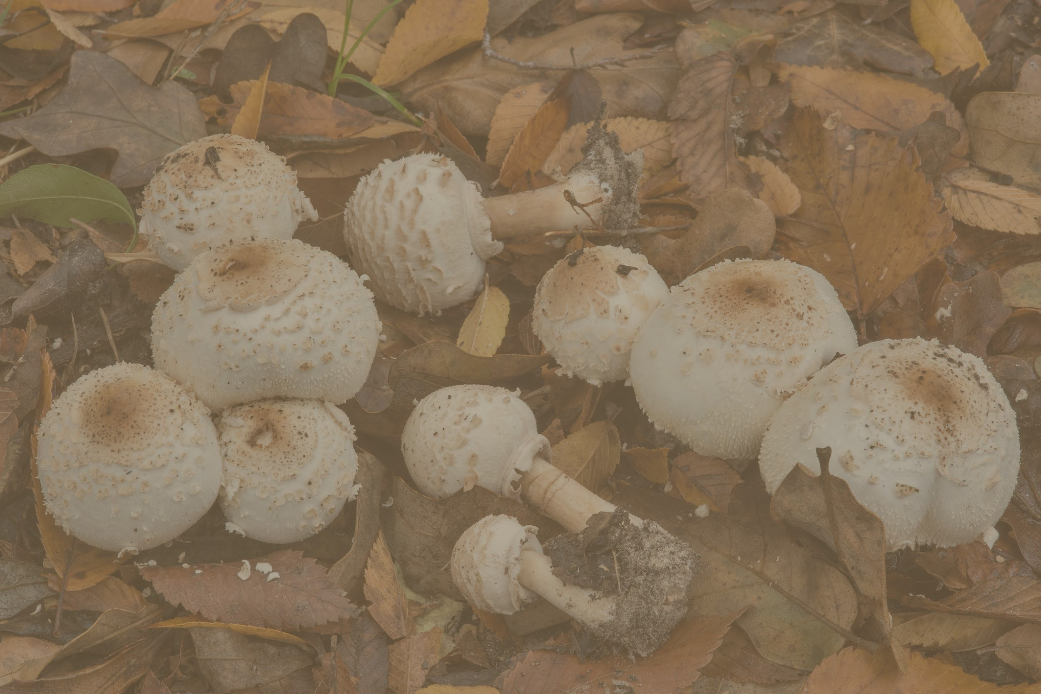
Models Used
KNN
Decision tree
SVM
Logistic Regression
Random forest
Adaboost

Slide 7
Metrics Used
Accuracy
Precision/recall
F-score
Cohen’s Kappa
ROC and AUC
Confusion matrix

Slide 8
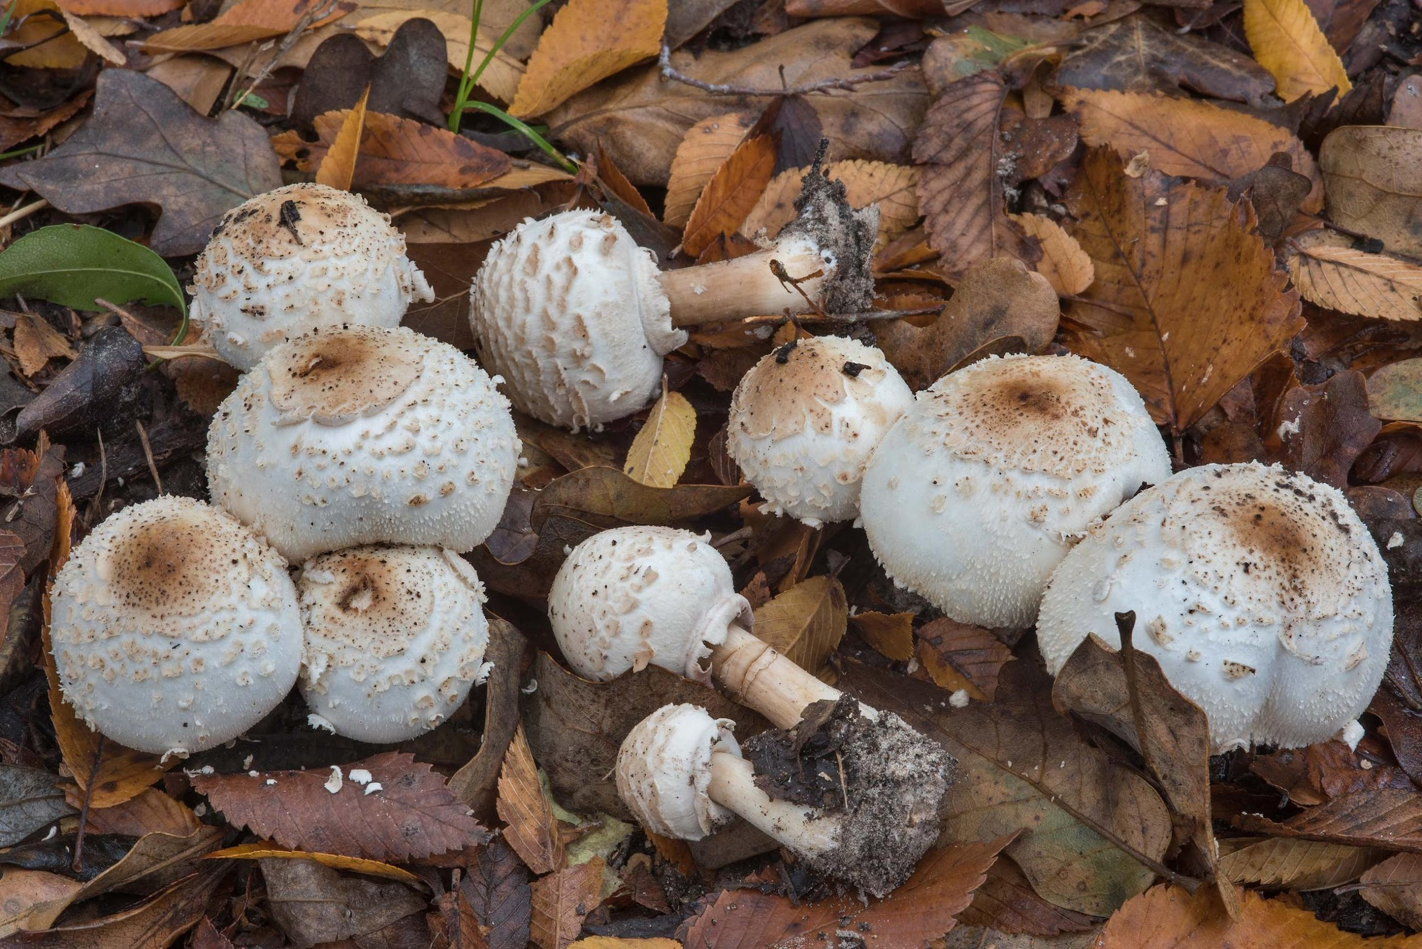
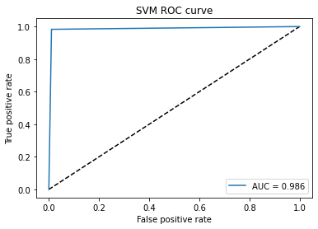
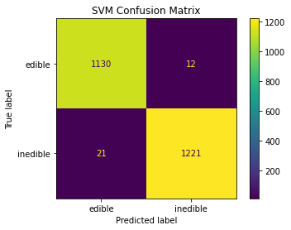
Accuracy: .986
Inedible F-score: .99
Edible F-score: .99
Cohen’s Kappa: .972
SVM Metrics

Slide 9
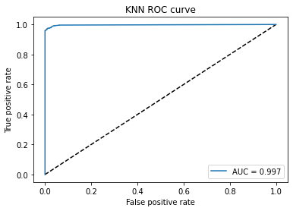

Accuracy: .954
Inedible F-score: .96
Edible F-score: .96
Cohen’s Kappa: .909
KNN Metrics

Slide 10
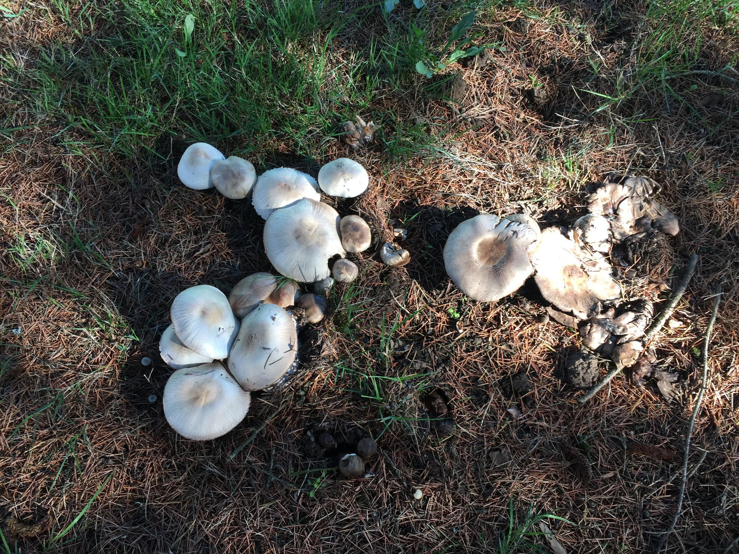
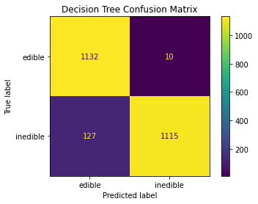
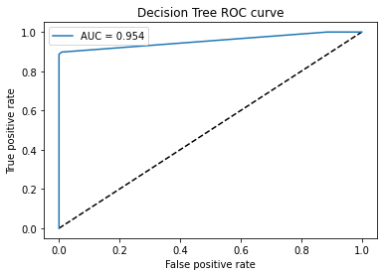
Accuracy: .98
Inedible F-score: .98
Edible F-score:.98
Cohen’s Kappa: .961
Decision Tree Metrics

Slide 11
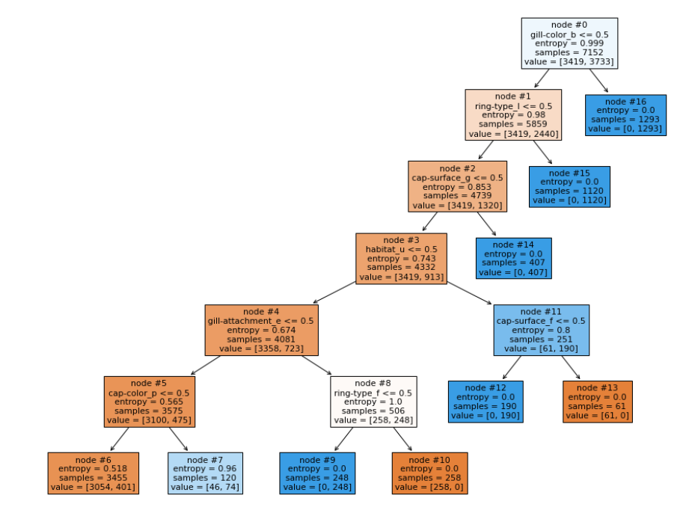

Slide 12
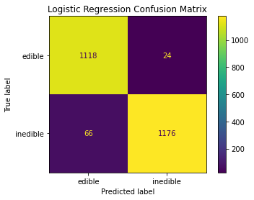
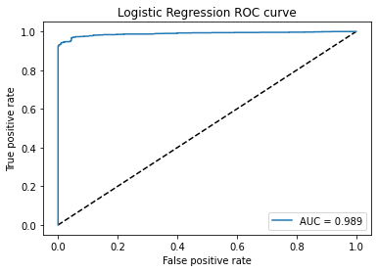
Accuracy: .943
Inedible F-score: .94
Edible F-score: .94
Cohen’s Kappa: .885
Logistic Regression Metrics

Slide 13
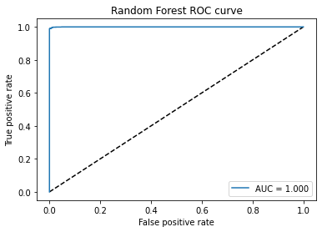
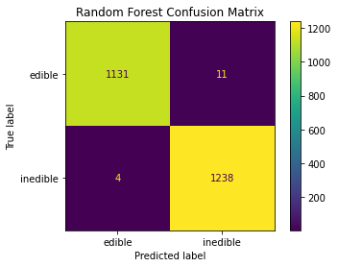
Accuracy: .994
Inedible F-score: .74
Edible F-score: .52
Cohen’s Kappa: .987
Random Forest
Metrics

Slide 14
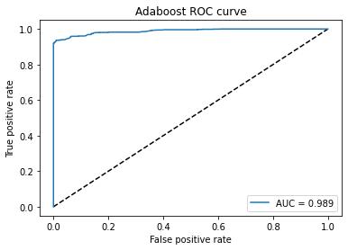
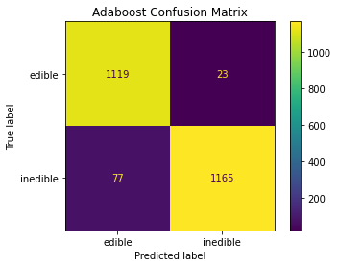
Accuracy: .958
Inedible F-score: .99
Edible F-score: .99
Cohen’s Kappa: .916
Adaboost Metrics

Slide 15
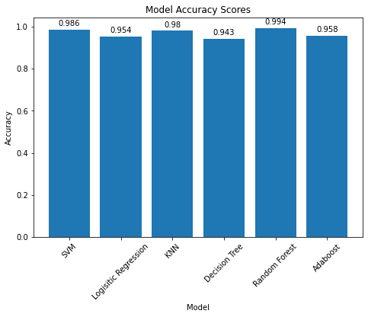
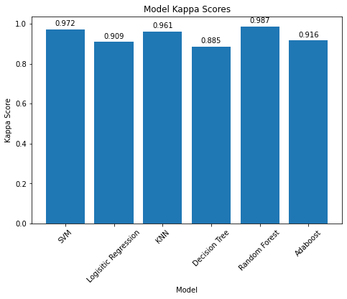
Comparison

Slide 16
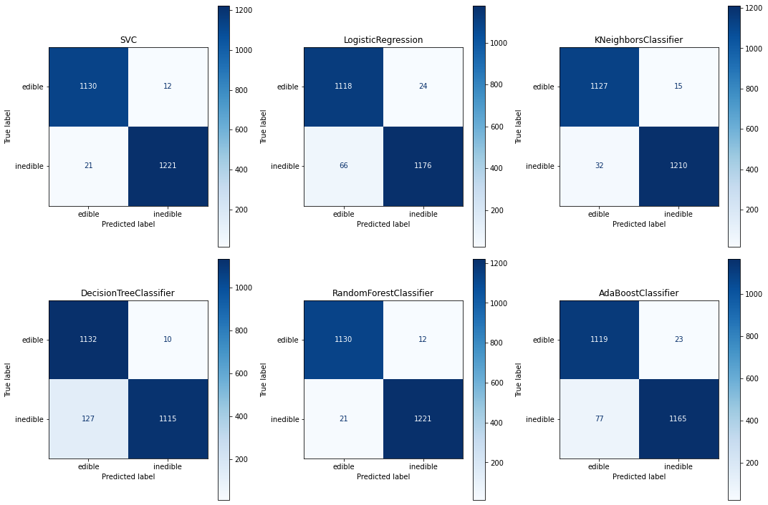
Comparison

Slide 17
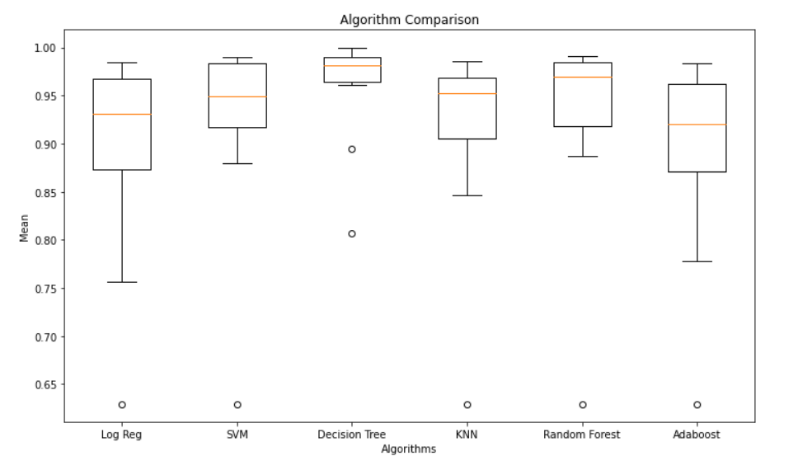
Comparison

Slide 18
Summary
Based on a few characteristics mushrooms can be easily identify as edible or inedible
Strongest correlation amongst attributes
gill color
veil color
gill attachment
veil type

Slide 19
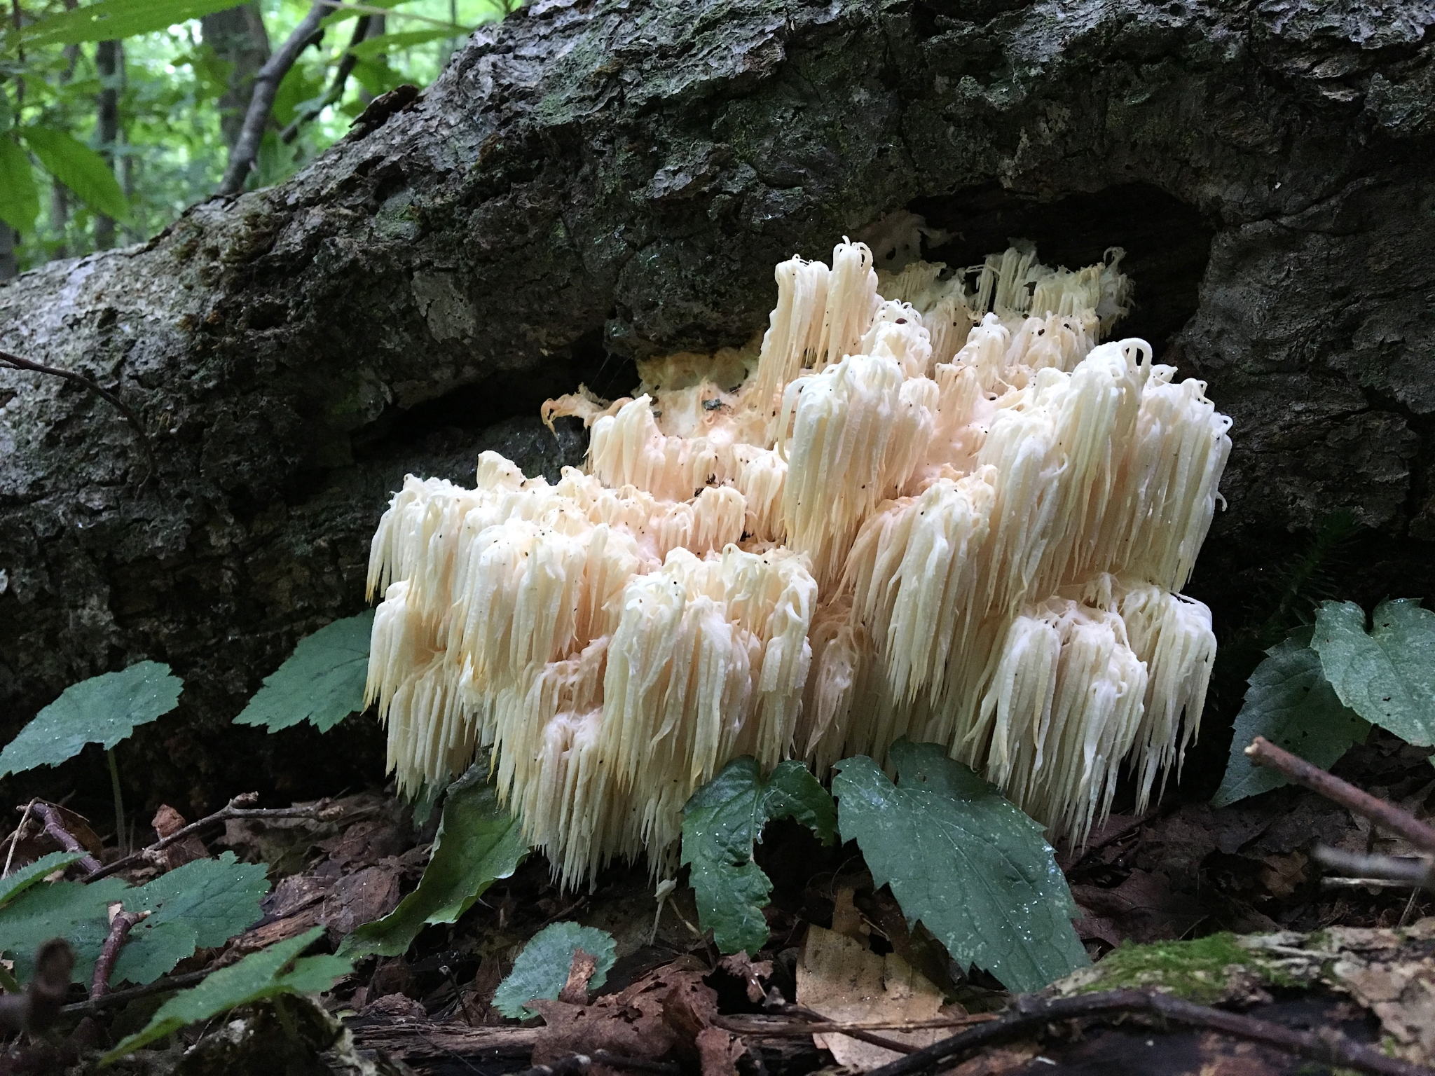
Next Steps
Add more contracting species to the dataset
Look into deep learning methods such as CNN
Allow users to ID from pictures
Collection of mushroom photos
accomplished by making app, allowing
users to upload their photos for
analysis
Lion’s Mane

Slide 20
Conclusion
Our model did a fantastic job at accurately predicting which mushroom would be poisonous and which would not
In this project we were able to combine 2 data sets from different time periods into a tidy dataframe
We picked out the metrics that most influenced their identification
After the final data set was codified, we then trained 6 different models to find which one would be the most accurate to the testing data.
Each of the ROC curves and confusion matrix were compared, and the Random Forest model ended up being the most accurate, with a 99% accuracy

Slide 21
References
Bhandari , A. (2020, July 20). AUC-Roc Curve in machine learning clearly explained. Analytics Vidhya. Retrieved December 9, 2021, from https://www.analyticsvidhya.com/blog/2020/06/auc-roc-curve-machine-learning/.
Brownlee, J. (2016, June 1). How To Compare Machine Learning Algorithms in Python with scikit-lean. Machine Learning Mastery. Retrieved December 2, 2021, from https://machinelearningmastery.com/compare-machine-learning-algorithms-python-scikit-learn/
Brownlee, J. (2020, August 14). What is a confusion matrix in machine learning. Machine Learning Mastery. Retrieved December 7, 2021, from https://machinelearningmastery.com/confusion-matrix-machine-learning/.
Desarda, A. (2019, January 17). Understanding AdaBoost. Towards Data Science, Retrieved November 20, 2021, from https://towardsdatascience.com/understanding-adaboost-2f94f22d5bfe
Widmann, M. (2021, October 31). Cohen's kappa: What it is, when to use it, and how to avoid its pitfalls. The New Stack. Retrieved December 9, 2021, from https://thenewstack.io/cohens-kappa-what-it-is-when-to-use-it-and-how-to-avoid-its-pitfalls/.

